Slide 1
Corporate Briefing Session

Slide 2
Table of Contents
Company Brief
Strategic and Operational Developments
Governance
Management of the Company
Shareholding Structure
Product Briefcase
Product Innovation and Digitalization
Financial Highlights
Premium Analysis
Business Alliance
Future Outlook
Q & A

Slide 3
Company Overview
Askari Life Assurance Co. Ltd, is part of one of the leading conglomerates in Pakistan, Army Welfare Trust (AWT).
AWT acquired the major shareholding of Askari Life in 2018 from East West Insurance Limited. AWT currently holds 54.54% of the shareholding.
Currently the authorized capital of Askari Life is Rs. 2 billion, out of which Rs. 1.10 billion is paid-up
We offer diversified product range including conventional and takaful products; savings and protection plan
Distribution channels include Sales Force, Bancassurance and Group marketing
Insurer Financial Strength rating of A- (Outlook: Stable) by PACRA
Askari Life is reinsured by leading Reinsurers in the market (Munich Re and Hannover Re)

Slide 4
Strategic and Operational Development
Strategic and Operational Development
2017
AWT acquired major shareholding from East West Insurance
2019
Branches restructuring and renovations
Introduction of new Universal Life Product and Bancassurance Agreement with Askari Bank Limited
Approval and Start of Window Takaful Operations
2018
Change of Name from East West Life to Askari Life Assurance Co. Ltd.
Injection of Rs.500 million through Right Issue
Restructuring of Management and Sales Force
2020
Bancassurance Agreement with Silk Bank Limited
Offer Right Shares for Rs.400 million

Slide 5
Company Governance

Slide 6
Company Management

Slide 7
Shareholding Structure (Audited) as at Dec 31, 2019

Slide 8
Product Briefcase
Askari Life offer following diversified product range including conventional and takaful products; savings and protection plan
Corporate Employee Benefit Product
Group Life Protection Plan
Conventional and Takaful Plan
Individual Life Product
Universal Life Saving Plan
Conventional and Takaful Plans
Term Life Protection Plan
Conventional Plan

Slide 9
Product Innovation and Digitalization
Askari Life strongly believe that innovative products and technological acumen are the key of success in the competitive environment of life insurance
In consideration of recent global pandemic a product named “Anmol Zindagi” offer a complete health and life protection plan having liberty to select an exclusive design packages
50% increased life insurance coverage that will provide in case of any eventuality due to Corona Virus
Individual Life savings products having diversity of Conventional and Shariah Compliant Takaful Products
Third party online portals and other digital channels are being introduced n the market which can help insurance industry to sell the products through internet
Facilitate customers and other stakeholders by online payment and receipt system that connect with Finance and Operation Department.

Slide 10
Financial Highlights

Slide 11
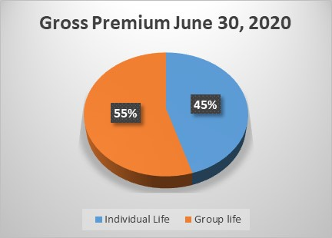
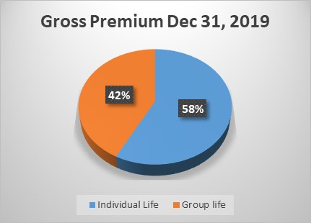
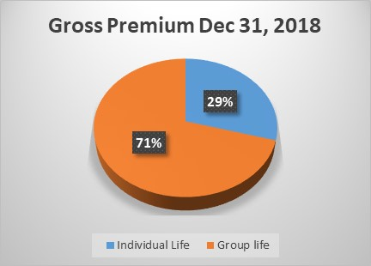
Premium Analysis

Slide 12
Business Alliance
Bancassurance
Askari Bank Limited
Silk Bank Limited
Reinsurance
Hanover Re
Munich Re
Corporate Clients
170+ Customers
242K+ Lives
Individual Policy holders
4400+ Lives

Slide 13
Future Outlook
Challenges
Economic conditions
Regulatory Compliance ( AML & CFT).
Covid – 19
Taxation on Saving Products
Lack of Awareness about insurance products
Add effective and trained Sales Force/Channel
Innovative Product
Technology driven business operations
Target the unapproached segment
Strategy

Slide 14
Question and Answer

Slide 15
Thank You

